Slide 1





GitHub Flow
Strategy Plan
New Learning Experience

Slide 2
Objectives
Decide GitHub Flow strategy so as -
Plan a branching strategy for team to work seamlessly.
Implement regular code reviews.
Implement automatic Junit testing during build process.
To implement CI / CD using GitHub Actions.

Slide 3
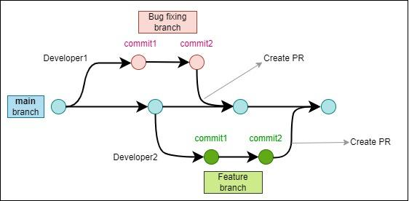
Branching strategy - Feature & Bug Fixing

Slide 4
New Feature Workflow
Scenario: A developer is assigned a feature for development.
The developer should create a feature branch giving a short but descriptive name which gives information about the feature.
All code changes must be made in the feature branch.
The developer should create a pull request from that feature branch to the main branch.
The pull request will be assigned to the two reviewers assigned for the project.
The reviewers will review the code and suggest any changes.
The developer has to do the suggested changes and the updated pull request is again reviewed by the reviewer.
Once the code is ready to be merged, the reviewers will approve the PR.
The pull request can be merged by the developer after being approved by the reviewers.

Slide 5
Bug Fixing Workflow
Scenario: A bug has been reported and needs to be fixed.
The bug reported appears as an issue and is assigned to a developer.
The developer should create a bug-fix branch from the main branch.
The name should indicate the Issue number and brief description about the issue.
The developer should fix the bug in the bug-fix branch.
The developer should create a pull request from the bug-fix branch to the main branch and link the PR to the issue.
The pull request will be assigned to the two reviewers assigned for the project.
The reviewers will review the code and suggest any changes.
The developer has to do the suggested changes and the updated pull request is again reviewed by the reviewer.
Once the code is ready to be merged, the reviewers will approve the PR.
The pull request can be merged by the developer after being approved by the reviewers.

Slide 6
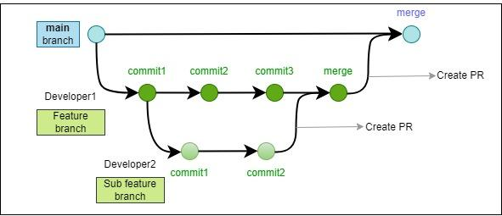
Branching strategy - A group of developers working on a feature

Slide 7
New Feature Workflow
Scenario: Two or more developers are assigned a feature for development.
The repository Admin should create a feature branch giving a short but descriptive name which gives information about the feature.
Each developer working on that feature will create a branch from Feature branch and work on that.
All code changes must be made by the developer in the respective branch.
The developer should create a pull request from his/her branch to the feature branch.
Each pull request will be assigned to the two reviewers assigned for the project.
The reviewers will review the code and suggest any changes.
The developer has to do the suggested changes and the updated pull request is again reviewed by the reviewer.
Once the code is ready to be merged, the reviewers will approve the PR.
The pull request can be merged by the developer after being approved by the reviewers.
After all the sub branches are merged to the feature branch, the feature branch is merged to the main branch.

Slide 8
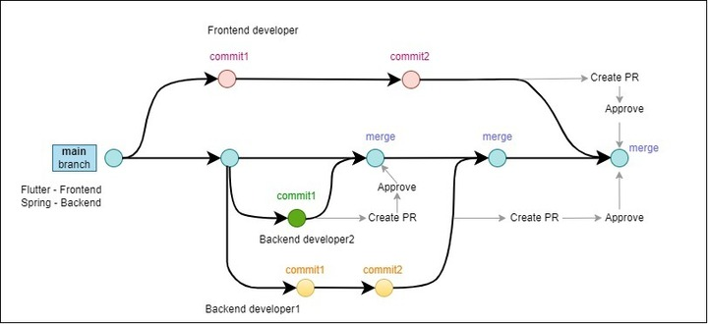
GitHub Action Implementation
Build trigger for every Push and Pull Request

Slide 9
Git Action Implementation
Build is done for every push and PR.
main.yml file includes two build jobs for frontend and backend build.
Currently the backend ‘.jar’ file is downloaded and deployed on our Development server.
Similarly, the build for front will also be downloaded and deployed on our Development server.

Slide 10

Thank you
Looking ahead for long and healthy relationship with your Organization !

